Slide 1
Engaging parents in the use of
mobile technology in schools
Simona Granfol
22 April 2015

Slide 2
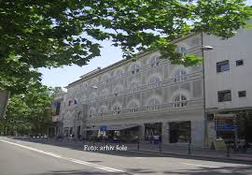
School Profile
founded in 1896 as Grammar school for girls
attended by 870 students, between the ages of 15 and 19
4 year course of study, prepares students for university
students complete their course of study with the Matura exam, the Slovenian national school-finishing exam (3 + 2 subjects); students who achieve a good result on the Matura are able to gain entrance to the most competitive departments at university
students and parents are very interested how school and teachers are working in order to get good results in exam
we have to see the projects also through the numbers/what are going to be learning outcomes
*more about school and projects: http://www.gjp.si/index.php/eng
2

Slide 3
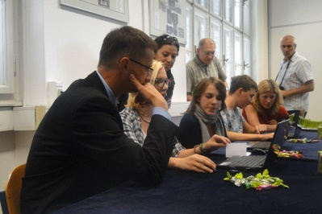
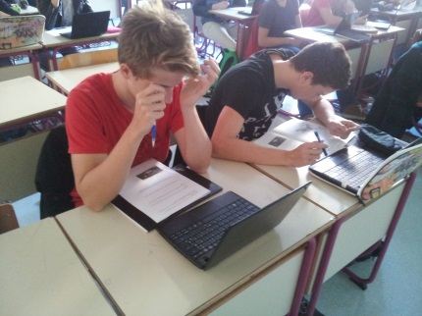
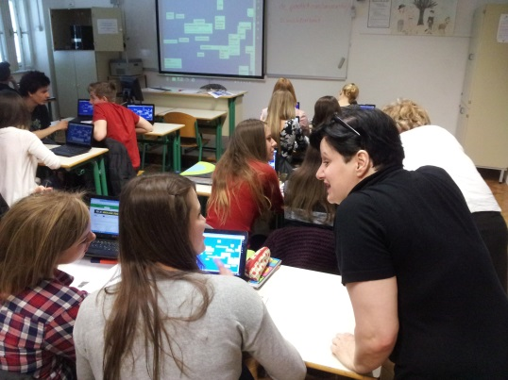
1:1 initiatives since 2009
starting with project Digital Literacy in 2009, mobile e-classroom (laptops)
1st netbook class in 2011: school bought with help of ministry netbooks for
every student (33) and teacher (12)
2nd netbook class in 2013/14:
parental consens was needed for the project, for data collecting and classroom observation
we are monitoring grades for all students in all subjects through all project and reporting results to the parents
3

Slide 4
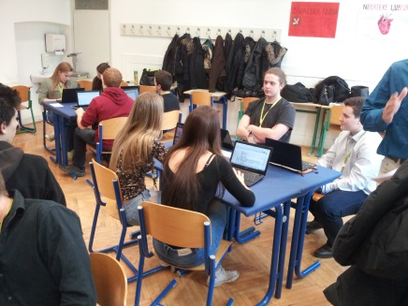
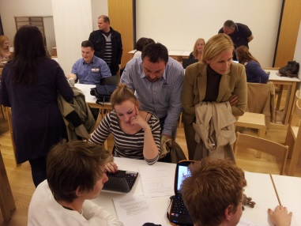
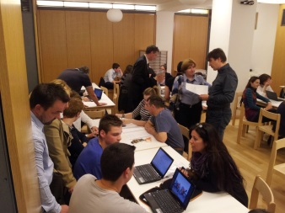
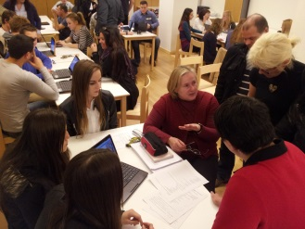
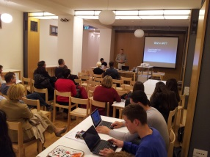
How we work with parents?
1. Informations about project progress and working in the classroom twice a year - regular
parents meetings with class teacher
2. Project days: open school/classroom, for parents opportunitiy
to see different activities in the school
(learning, teaching, projects etc.)
3. special presentation and workshop for parents and use of ICT for learning from viw of the students: activities with ICT for each subject; meeting is organised in form of learning stations and small groups of parents are going around, listening to the students and speaking to the teacher; they can also try some of the ICT activities, their children are doing in the classroom
4

Slide 5
How we work with parents?
4. Working together with „Parent-school“: lecture for parents – Internet and how to set the right rules at home
5. Working together with „Safe.si“: round table on the Internet safety
6. ARNES
5

Slide 6
Q1: What are the rules in the school?
Students are allowed to have open computer on the table, if the learning activitie is organised with ICT – teacher has to say it
2. Students get the laptop with Windows and installed programms ; they are allowed to download other programms if used for learning/classroom, informing/asking the technical support
They are obliged to take care of the laptop in the way to install updates, charge the
battery at home etc.
They have to learn how to use Moodle, have Edoroam account, know how to organisie documents for different subjects together
5. They can choos between taking notes on computer or on the paper; teachers are checking on the students
Teachers can act, if student are going on fb or playing game instead of carrying out
learning activites
6

Slide 7
Q2: Parents have to know the strategy of using ICT in the school?
We are planing learning activities with use of ICT:
1. to get better support for different methods/ways of working (group, individual, collaborative etc.)
to increase motivation
to support learning process (visualisation, repetition, checking the result …)
This areas of positive impact/influence were named by our students in the school evaluation/research ( www.sirikt.si)
7

Slide 8
The voice of parents
Are you happy, to have a child in this project class? Why? | 100% yes. I see the need of Digital Literacy at work.
Which activities with ICT do you finde especially good? | Different exercises, e-dictionary, searching information on internet, …
Is use of ICT influencing the quality of the teaching? | There are good and not so good teachers – regardless of technology.
Are your children more motivated to learn with the ICT? | It depends on fact, how good planned is the activitie and how meaningfull is it to the students.
8

Slide 9
Thank you!
Read more: http://creative.eun.org
Contact us: creativeclassroom@eun.org
The work presented on this document is supported by the European Commission’s Lifelong Learning Programme – project Creative Classrooms Lab (Grant agreement 2012–5124/005-001). The content of this document is the sole responsibility of the consortium members and it does not represent the opinion of the European Commission and the Commission is not responsible for any use that might be made of information contained herein.
9

